Slide 1



Predicting Rainfall in London-Heathrow Using Machine Learning on 2000-2010 Meteorological Data
Christian Campbell

Slide 2


The Importance of Rain Prediction for Heathrow
Accurate rain forecasting is critical for aviation, logistics, and event planning.
Aims to minimize flight delays and disruptions.
Helps optimize scheduling and safety protocols.

Slide 3

Brief History of Weather Forecasting
Originated around 650 BCE with Babylonians.
Significant advancements in the 19th and 20th centuries.
Importance in daily life and industry.

Slide 4

Understanding the Dataset
Data sourced from ECA&D via Kaggle.
Includes 3,654 days of observations from 2000-2010.
Variables: temperature, cloud cover, humidity, etc.
Data was pre-cleaned.

Slide 5

Methods and Models
Created a binary rain indicator from precipitation data.
Used logistic regression and random forest models.
Evaluation metrics: accuracy, precision, recall, F1 score.

Slide 6
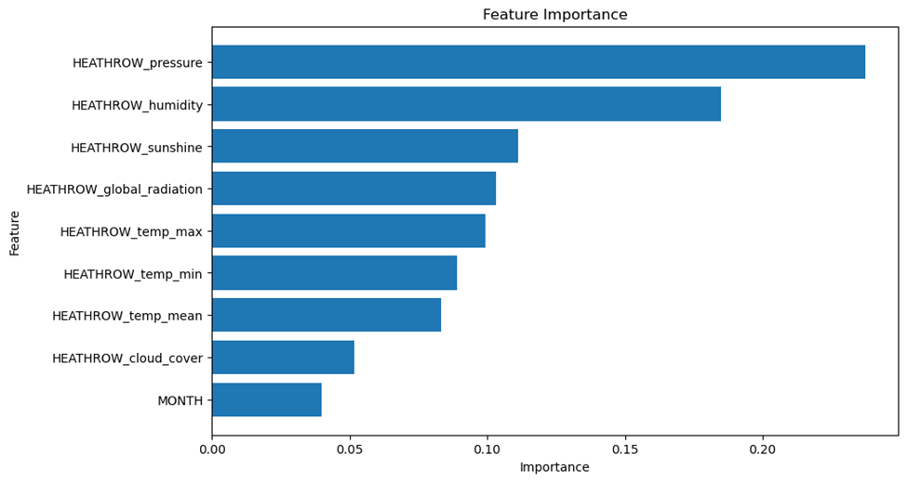
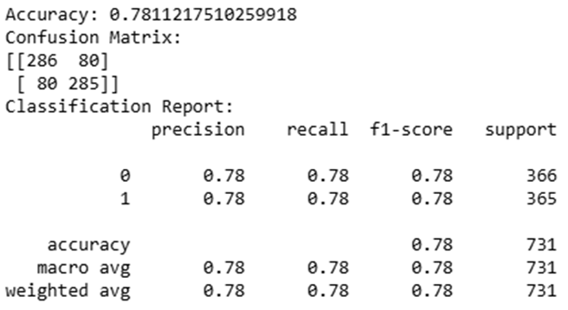
Results and Analysis
Random forest outperformed logistic regression.
Random forest accuracy: 78%, logistic regression: 73%.
Key features: pressure, humidity, sunshine, global radiation.

Slide 7
Conclusion
Machine learning effectively predicts rain at Heathrow.
Random forest model was the most accurate.
Significant features: pressure and humidity.

Slide 8

Assumptions of the Project
Data quality was assumed sufficient.
Daily data was adequate for predictions.
Binary rain indicator simplified target variable.

Slide 9
Project Limitations
Limited to data from 2000-2010.
Focused only on Heathrow.
Used basic models (logistic regression and random forest).

Slide 10
Recommendations for Future Work
Expand the dataset to include recent data.
Use more complex models.
Apply methods to other airports and industries.

Slide 11
References
Kaggle. (n.d.). Weather prediction dataset. Retrieved October 28, 2024, from https://www.kaggle.com/datasets/thedevastator/weather-prediction/data?select=metadata.txt
Klein Tank, A. M. G., & Coauthors. (2002). Daily dataset of 20th-century surface air temperature and precipitation series for the European Climate Assessment. International Journal of Climatology, 22(12), 1441–1453. https://doi.org/10.1002/joc.773
Huber, F., van Kuppevelt, D., Steinbach, P., Sauze, C., Liu, Y., & Weel, B. (n.d.). Will the sun shine? – An accessible dataset for teaching machine learning and deep learning. DOI TO BE ADDED!
Gaitán, C. F. (2018, May 20). Only happy when it rains: A brief history of weather forecasting. Arable. https://www.arable.com/blog/only-happy-when-it-rains-a-brief-history-of-weather-forecasting/

